Slide 1
Flip-Flopping the Appalachian Trail
June 5, 2015 – December 7, 2015
“Clarity”

Slide 2
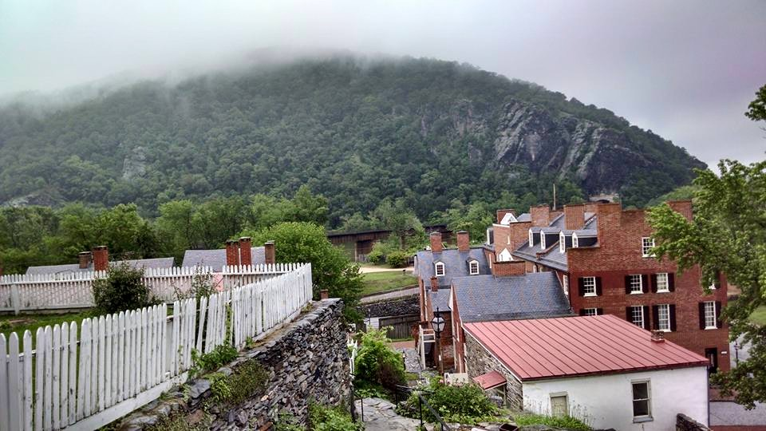
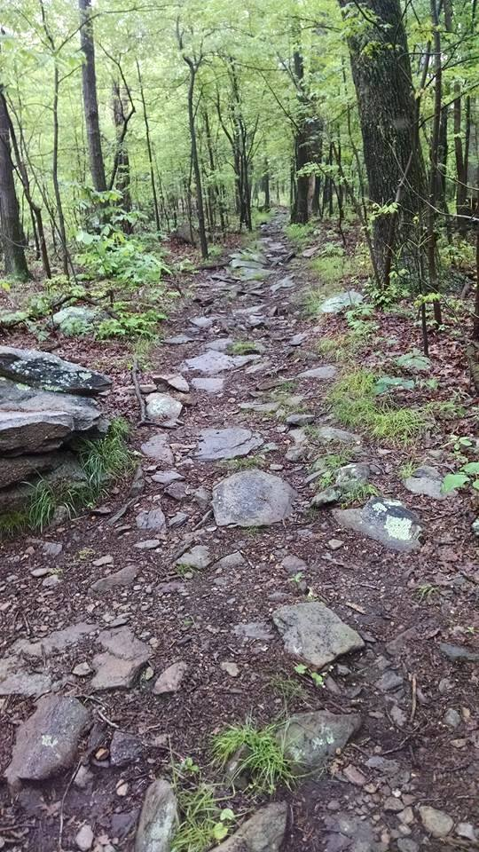
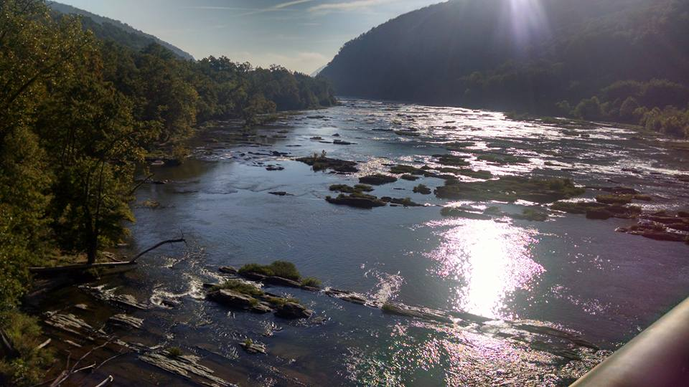
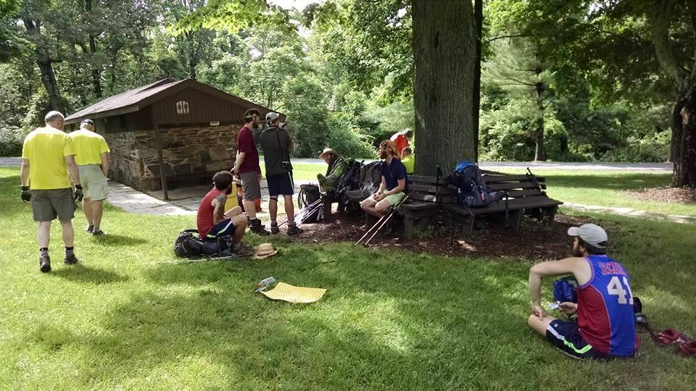
West Virginia 20 miles
A flip-flop thru-hike means a hiker starts her journey in a less conventional spot on the trail, usually in WV.

Slide 3
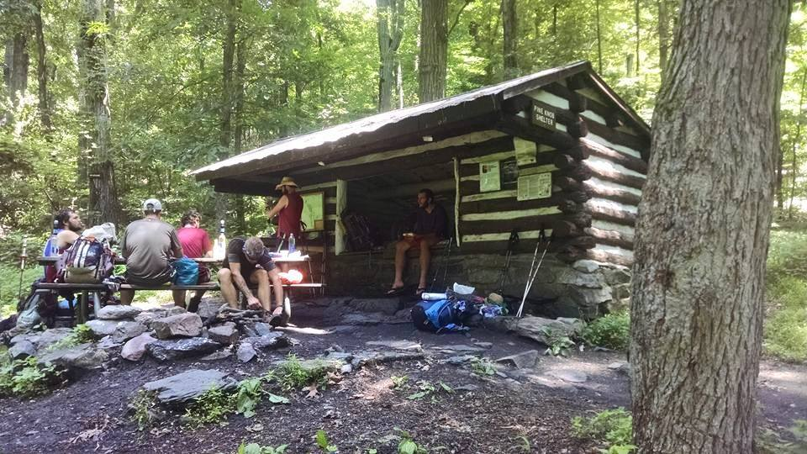

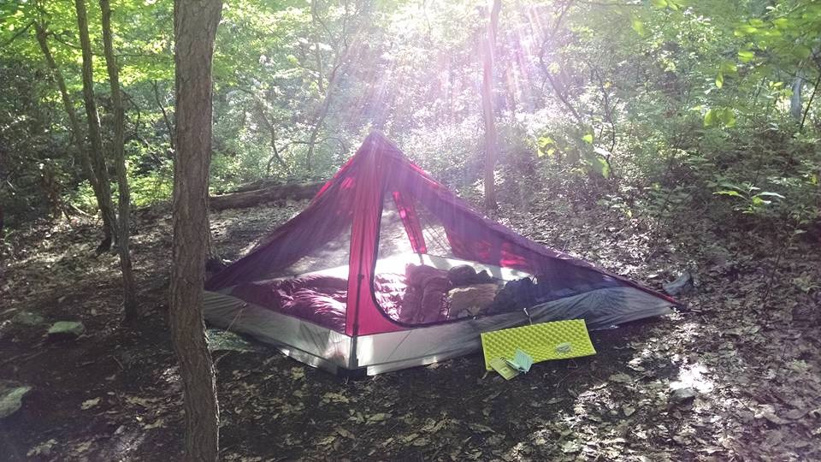

Maryland 42 miles
Flip-floppers are 57% likely to complete the whole trail compared to 26% of NOBO and 31% of SOBO hikers.

Slide 4
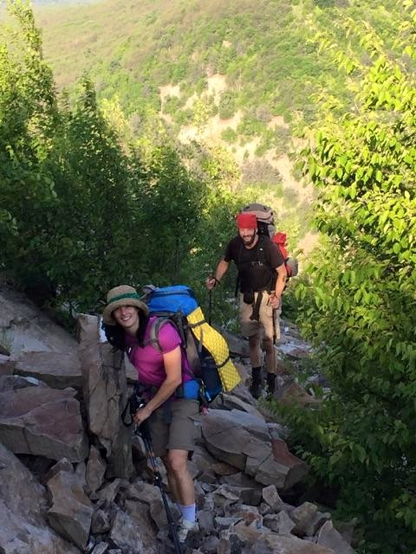
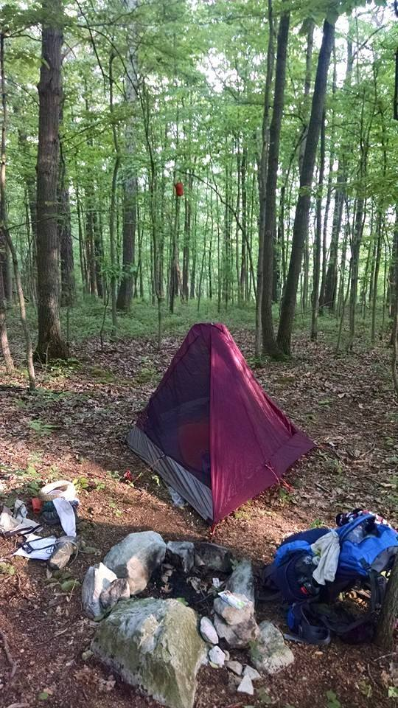
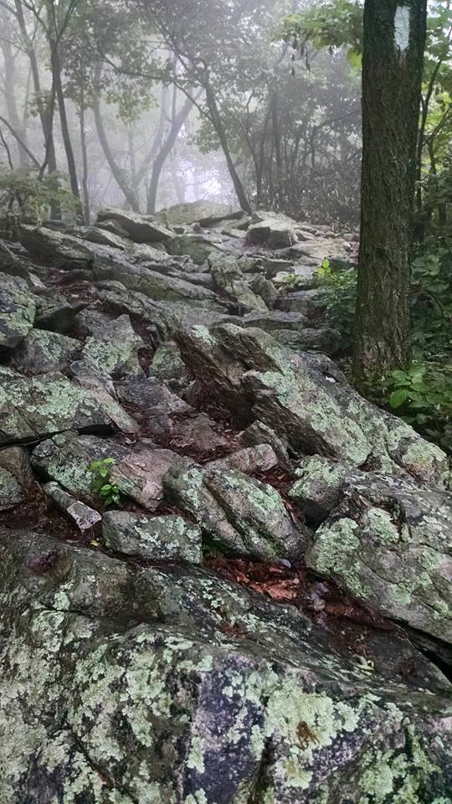
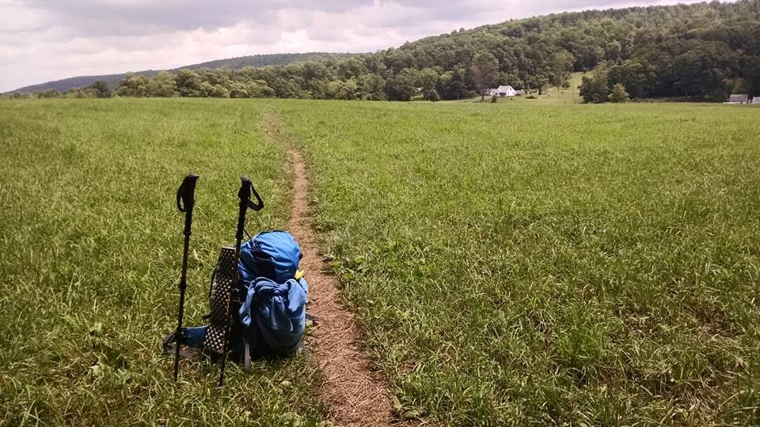
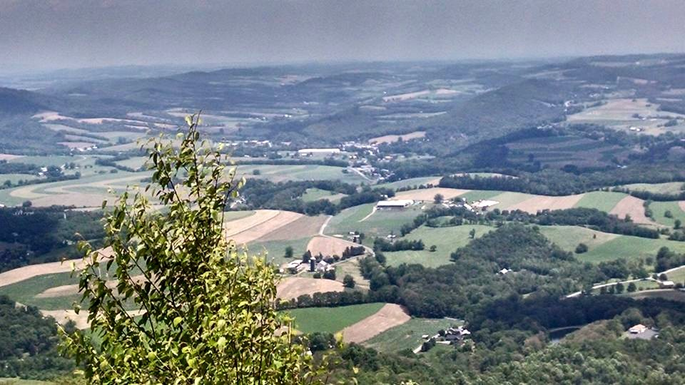
Pennsylvania
“The Shoe Destroyer”
230 miles
Flip-floppers enjoy a less crowded trail which means easy access to camping, privies that aren’t grossly overfilled, and less of a “traffic jam” feel throughout the hike.

Slide 5
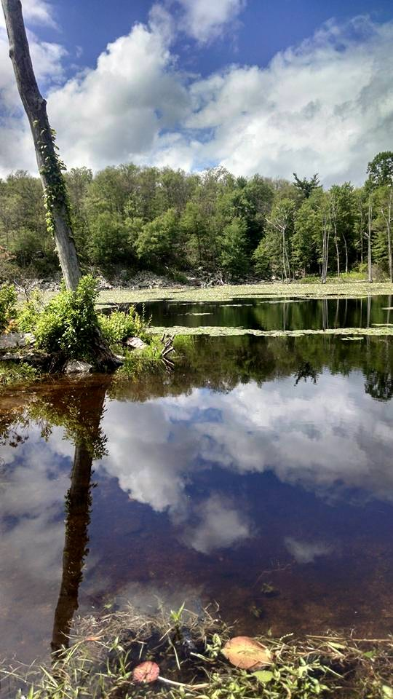

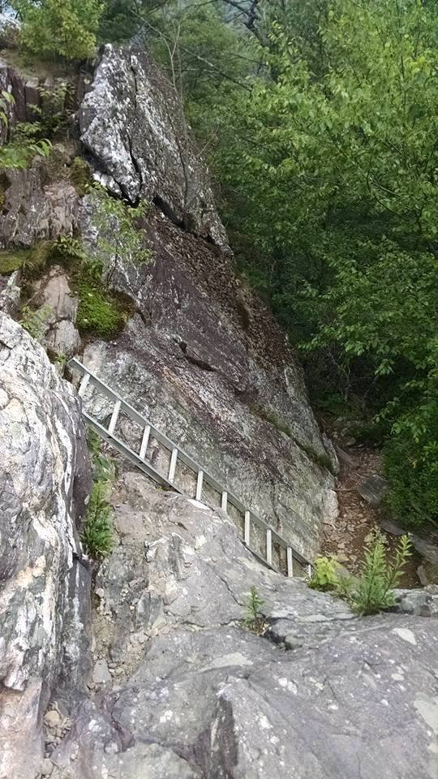
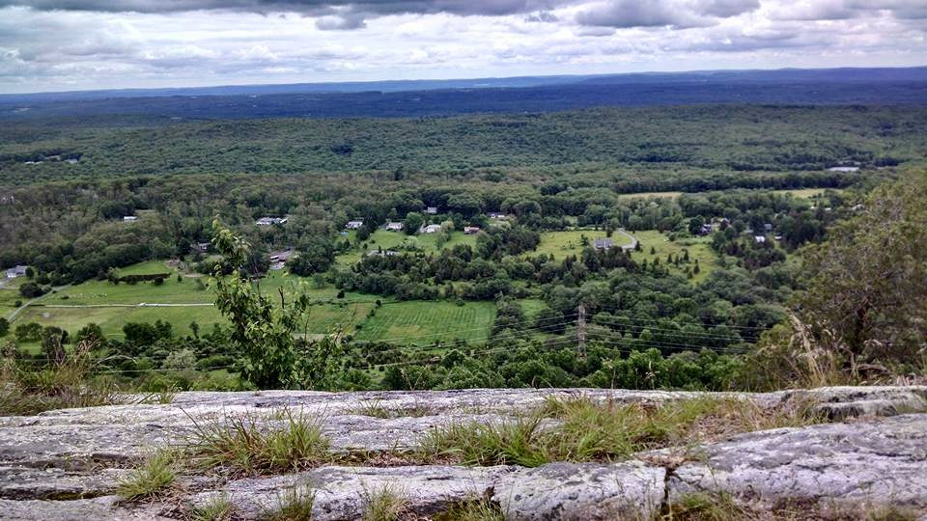
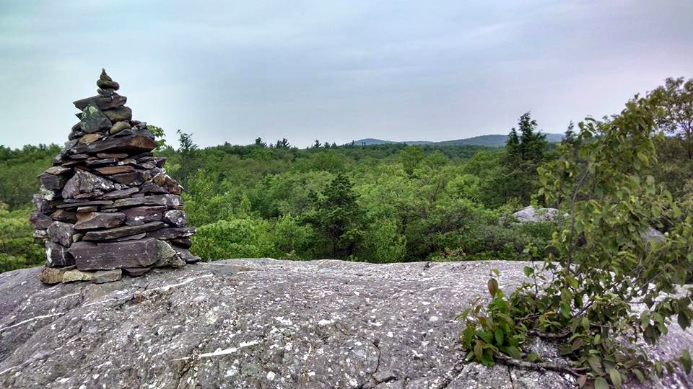
New Jersey 72 miles
The less crowded trail is also less destructive to the trail itself. Trail erosion and human impact are reduced.

Slide 6

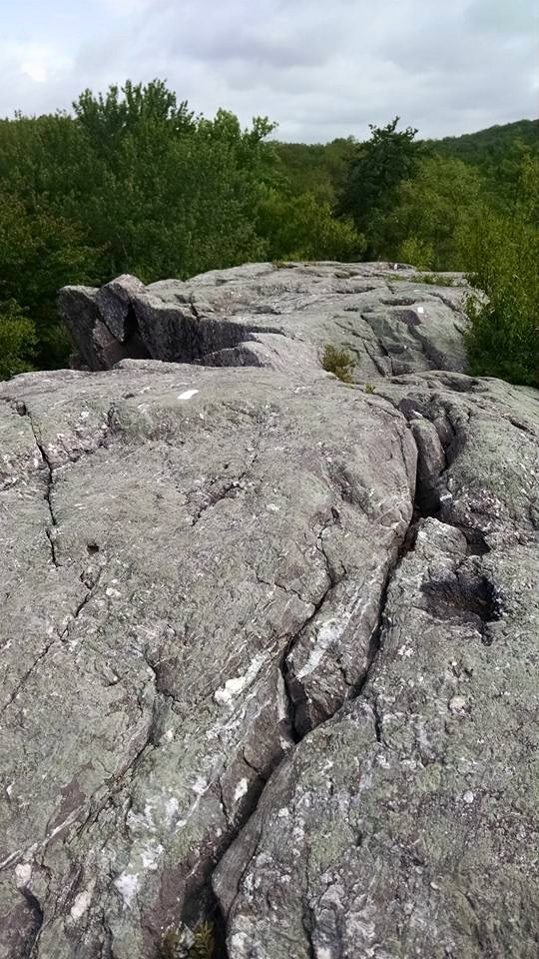
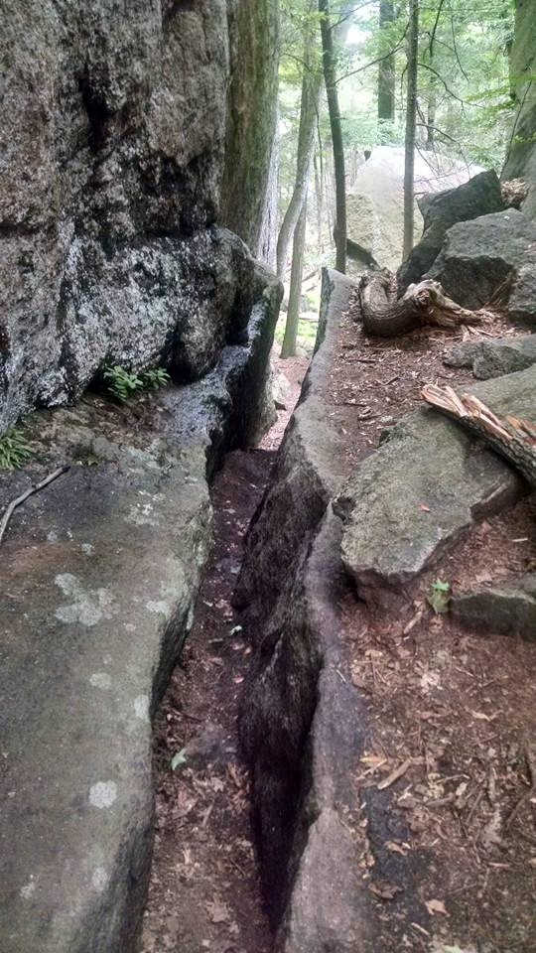
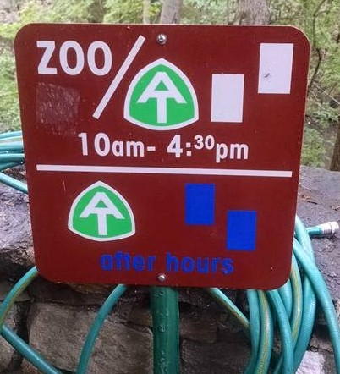
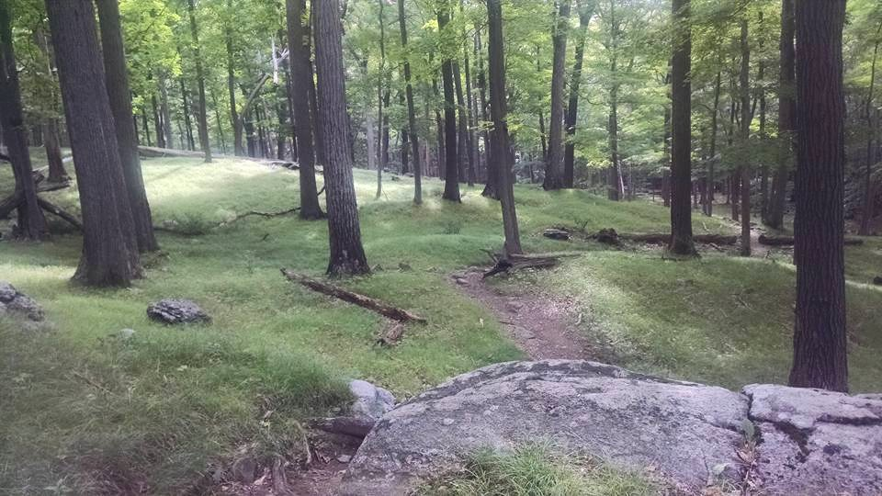
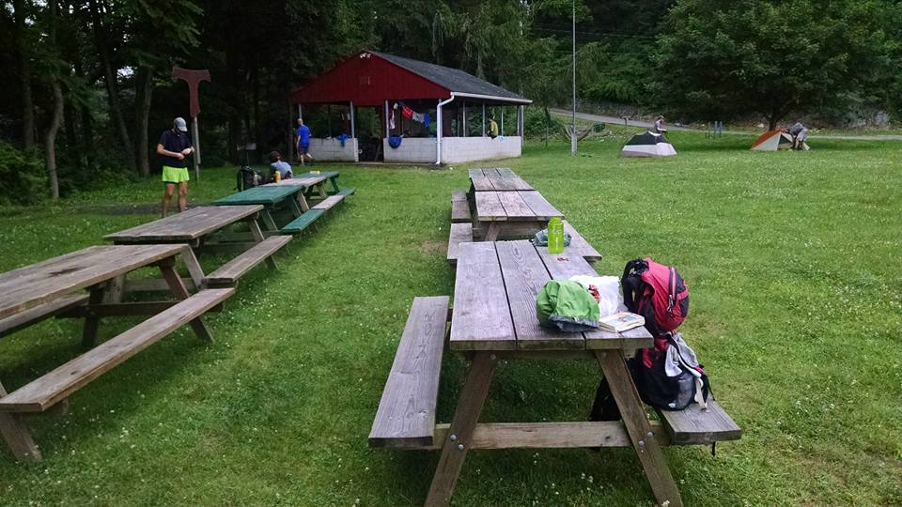
New York 88 miles
Flip-floppers enjoy more of a social experience on the way north and more of a solitary experience going south, so you get the best of both worlds!

Slide 7
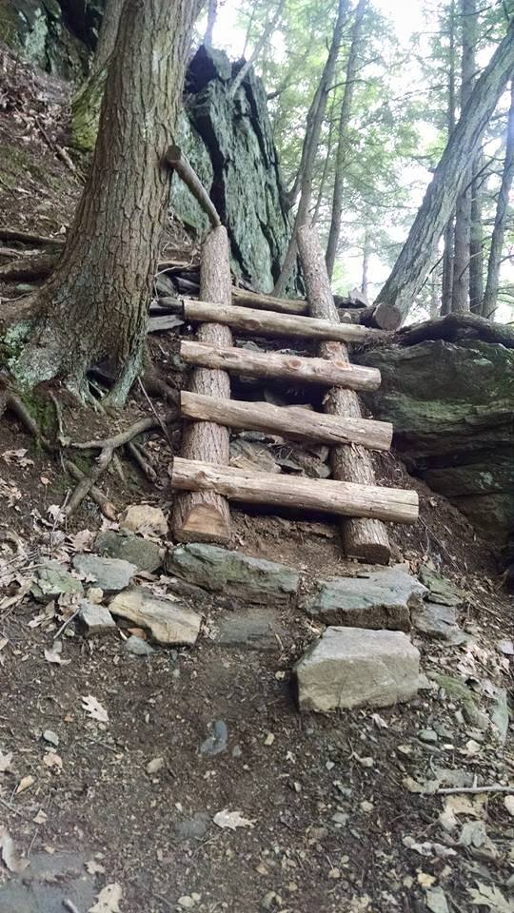

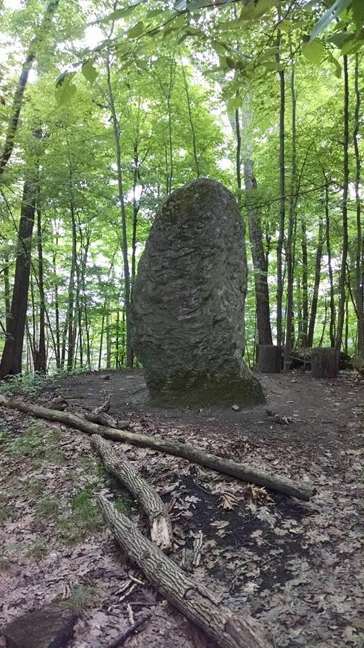
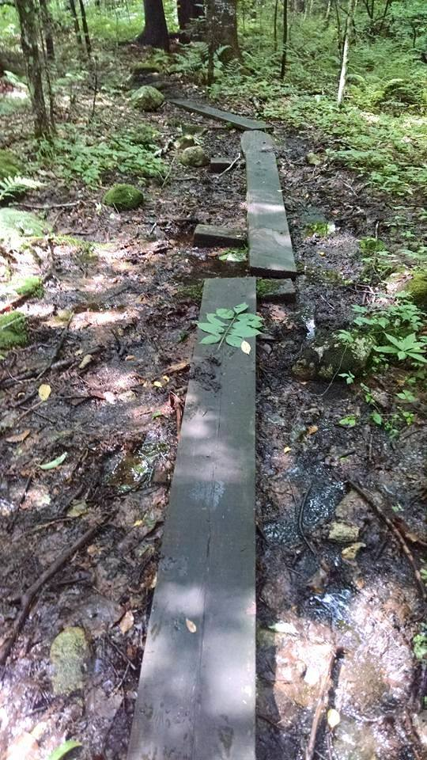
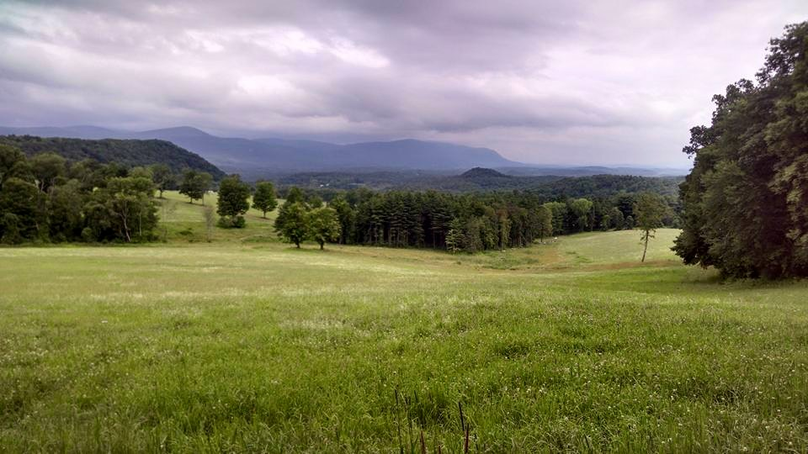
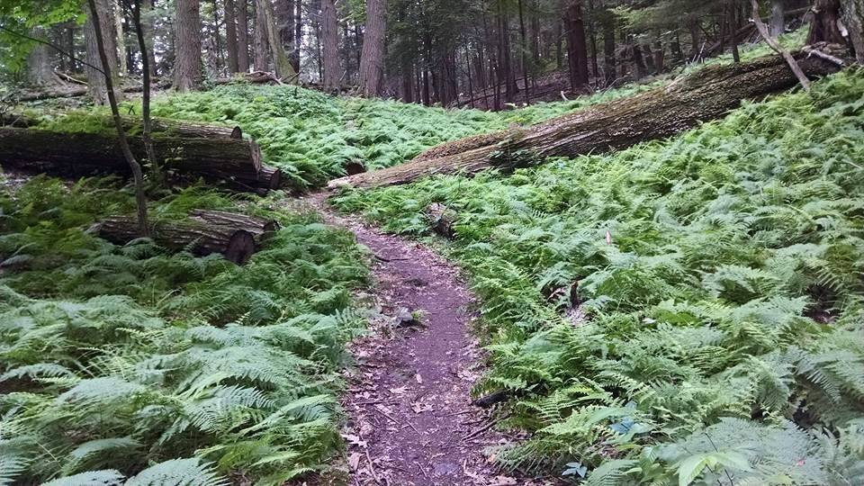
Connecticut
51 miles
Flip-floppers have a longer hiking season.

Slide 8

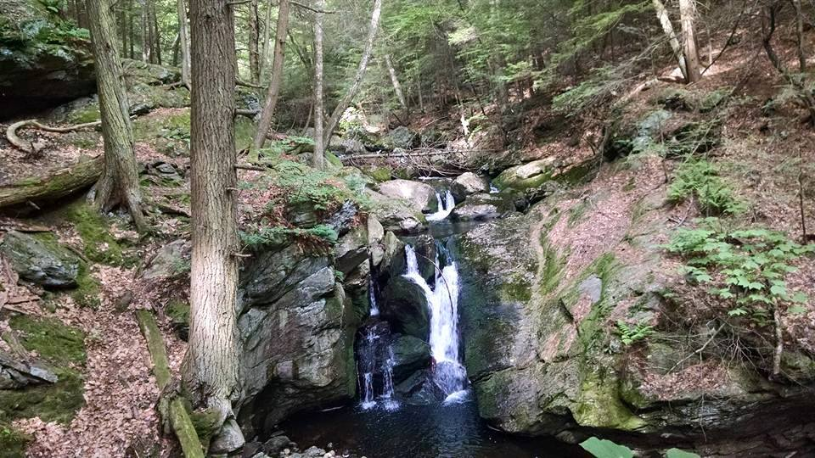
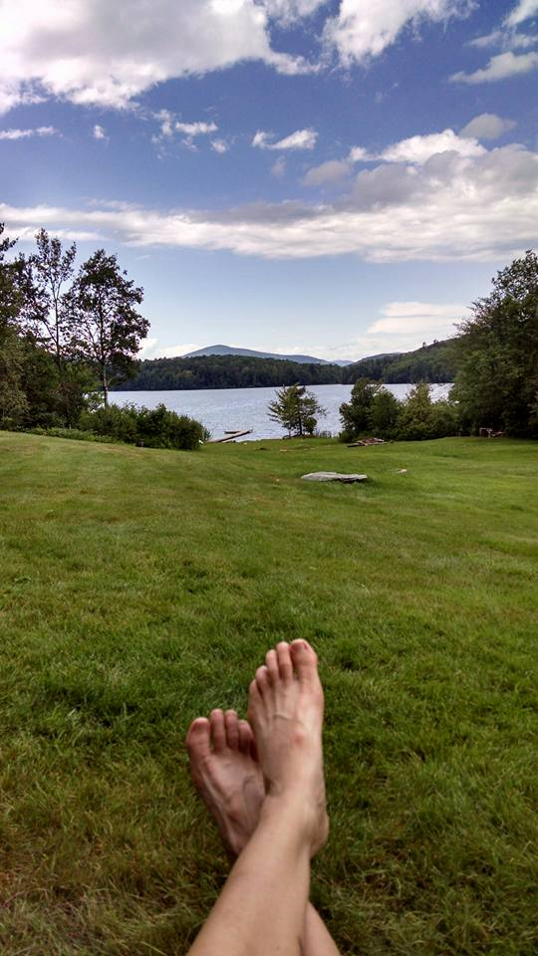

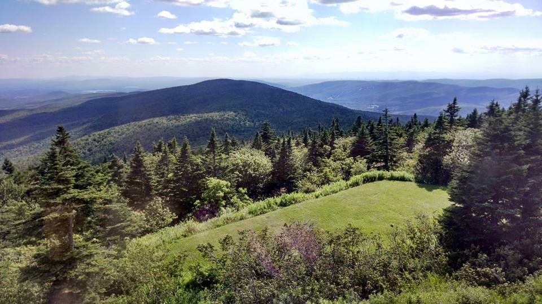
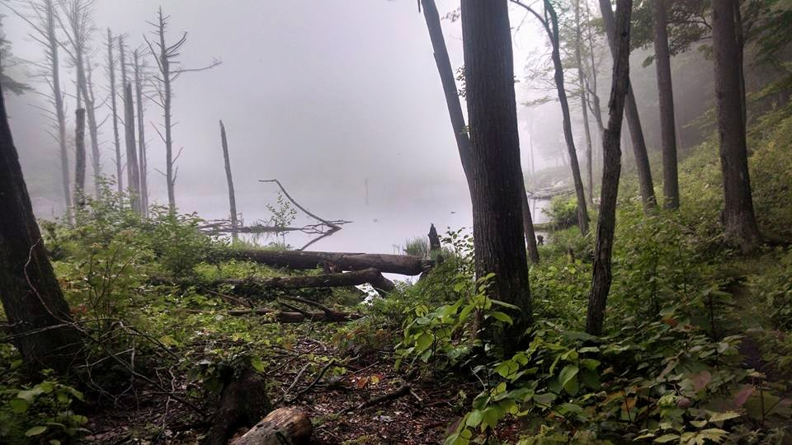
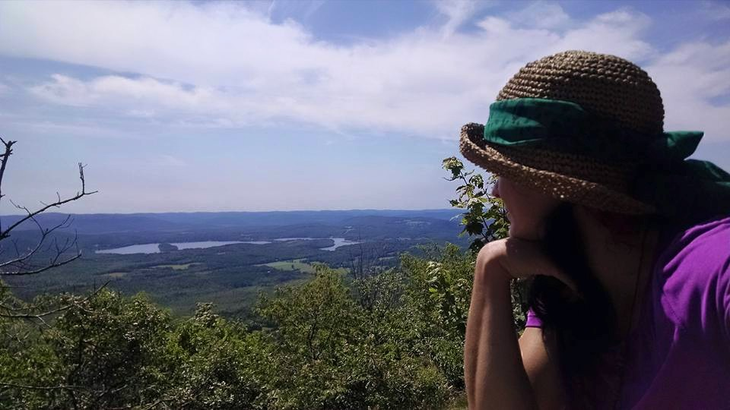
Massachusetts 90 miles
Flip-floppers build our “trail legs” gradually.

Slide 9
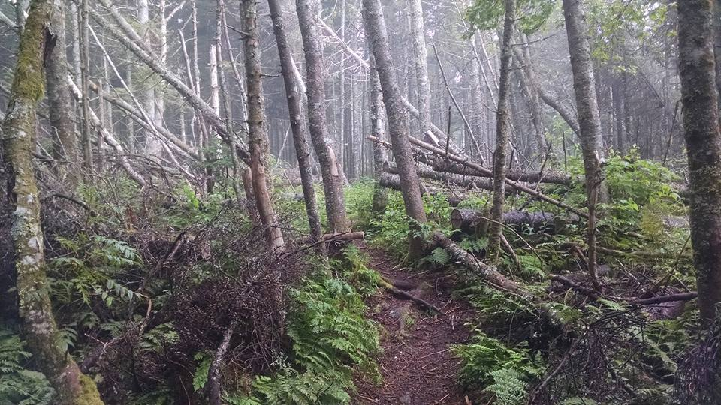
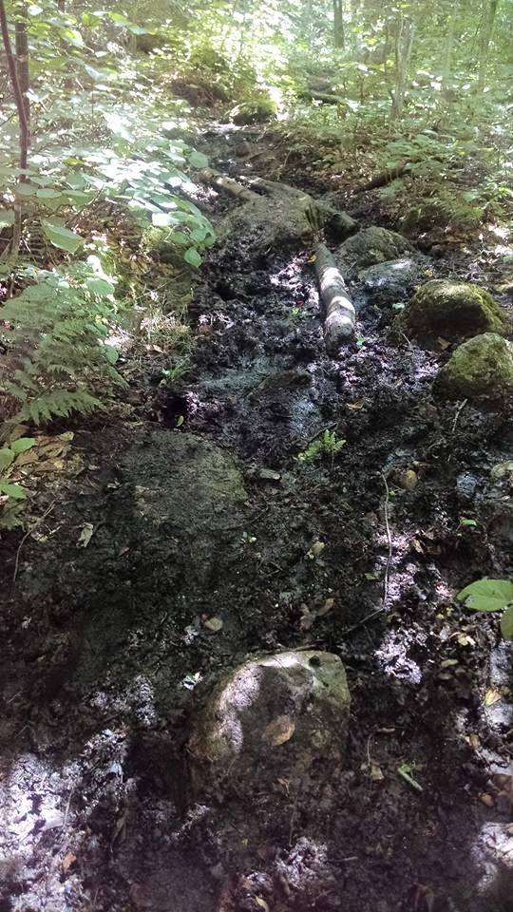
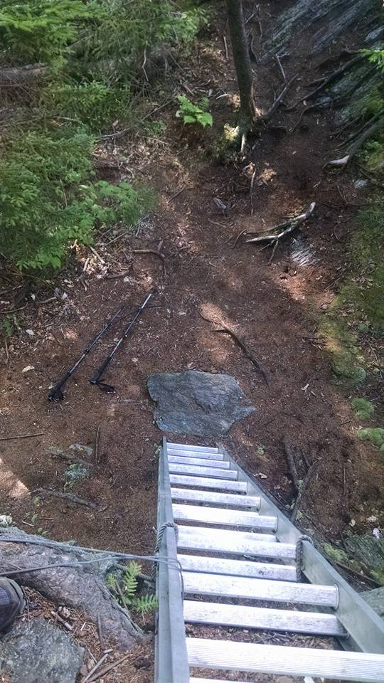
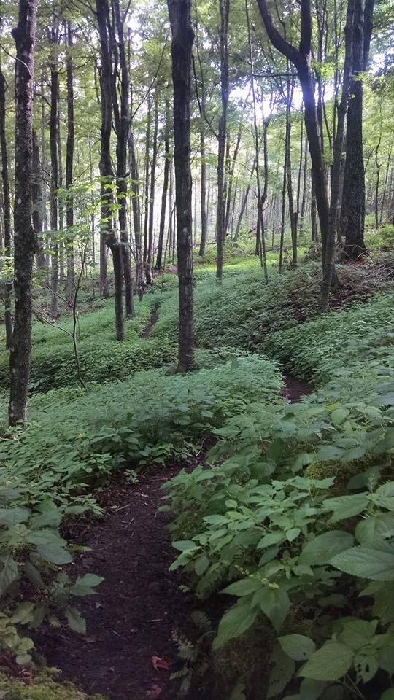
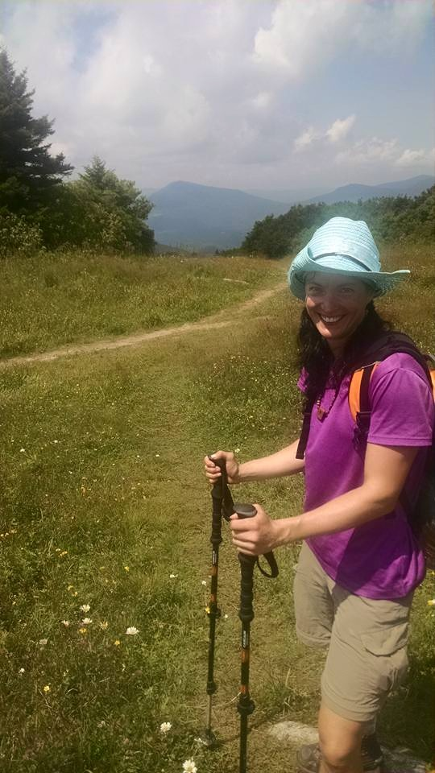
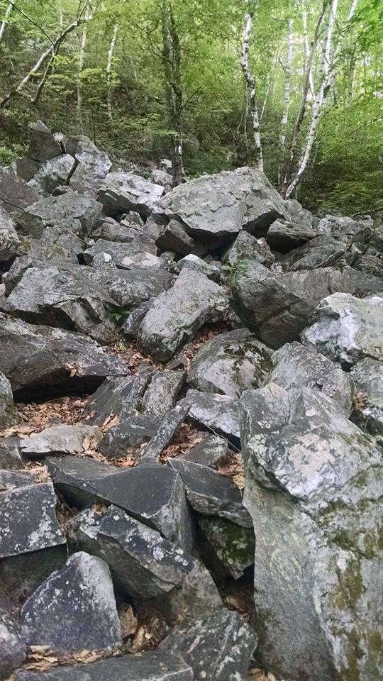
Vermont “Vermud” 150 miles
Flip-floppers get the best temperatures! We’re up north in the hottest months and down south in the coolest.

Slide 10

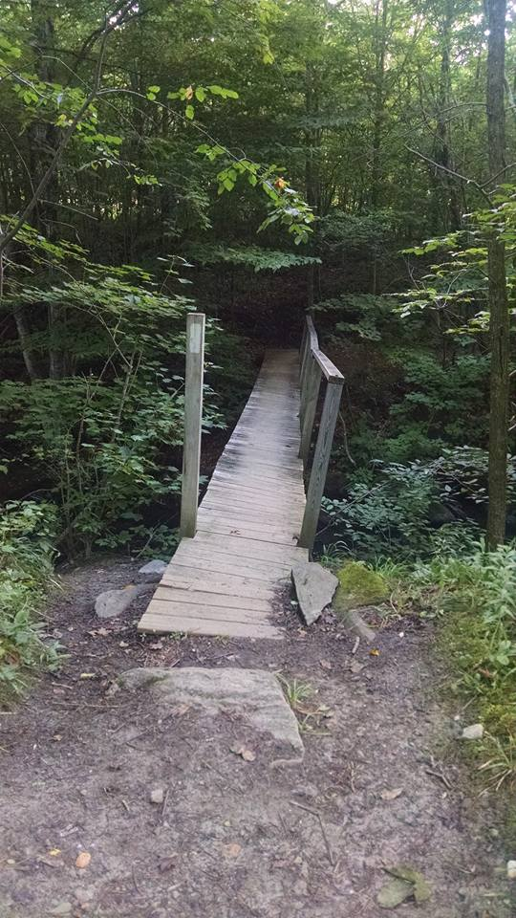

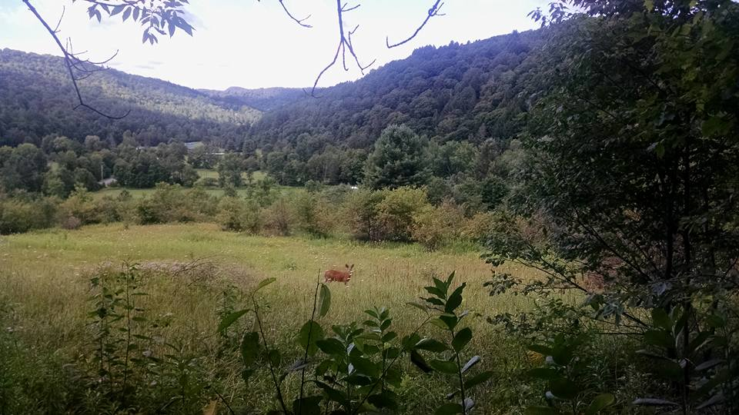
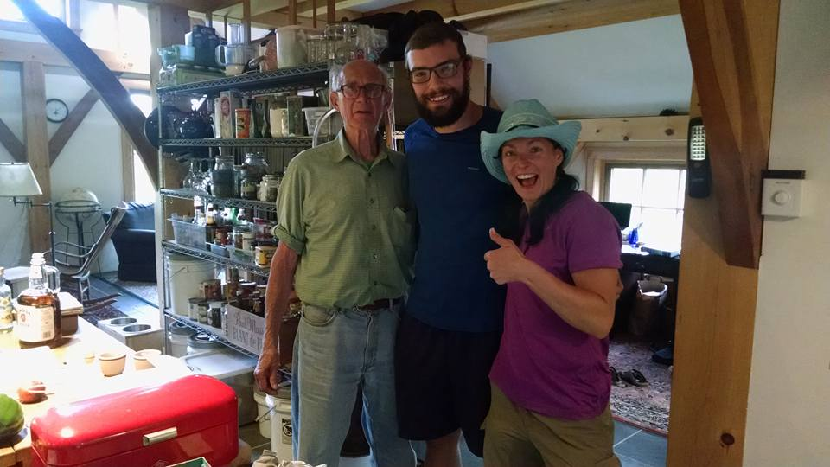
More Vermont. Sorry.

Slide 11
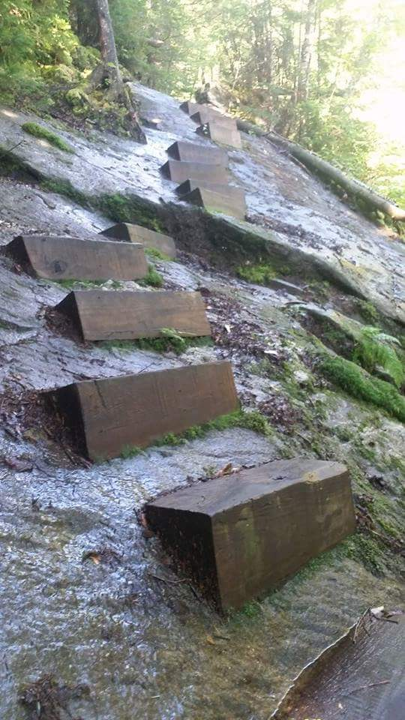
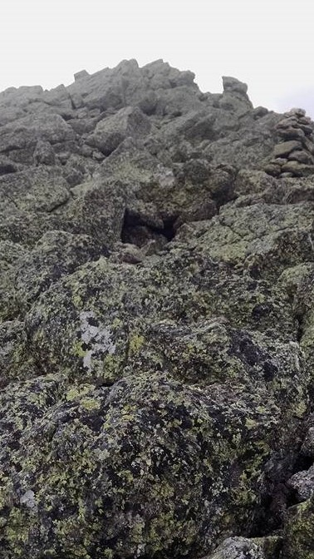
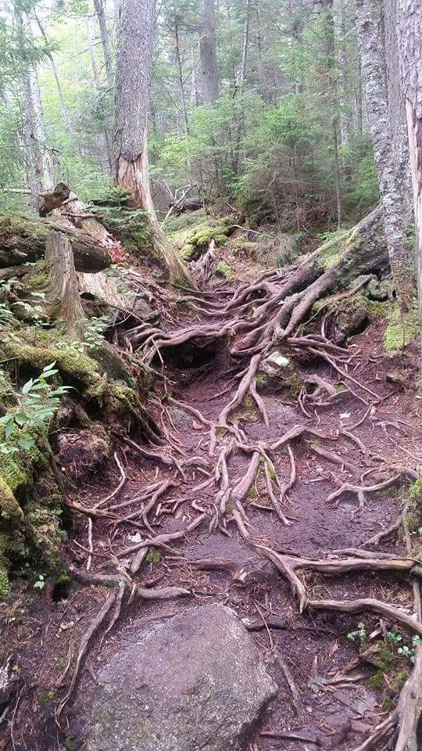
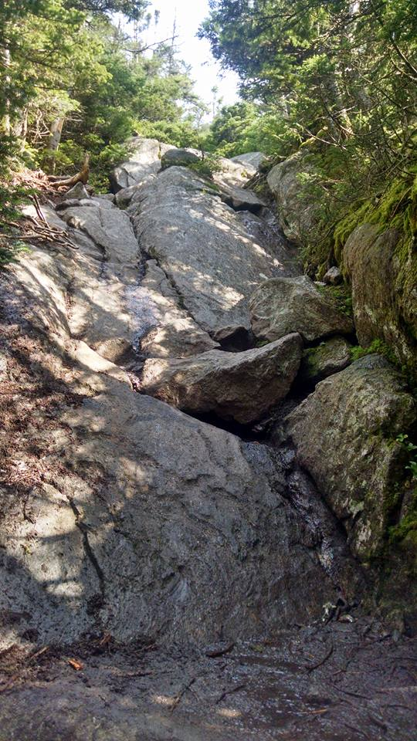
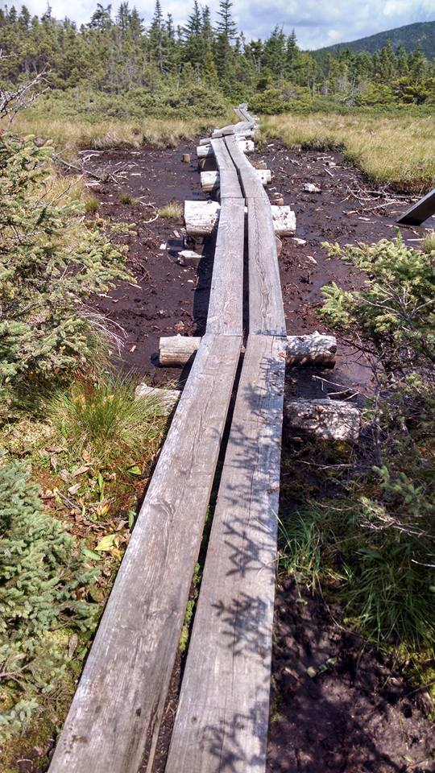
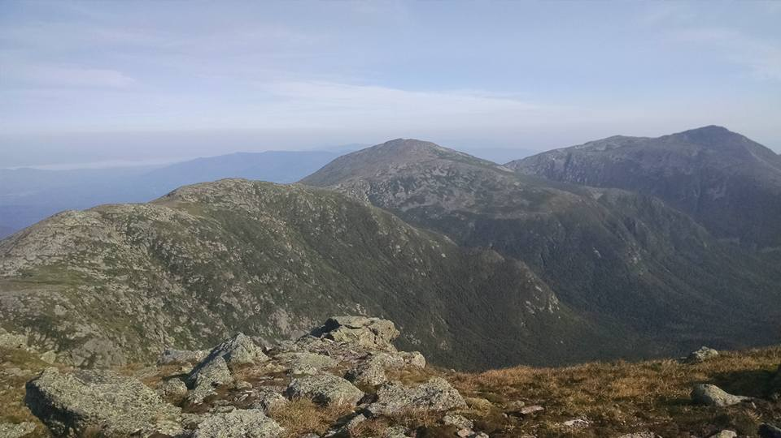
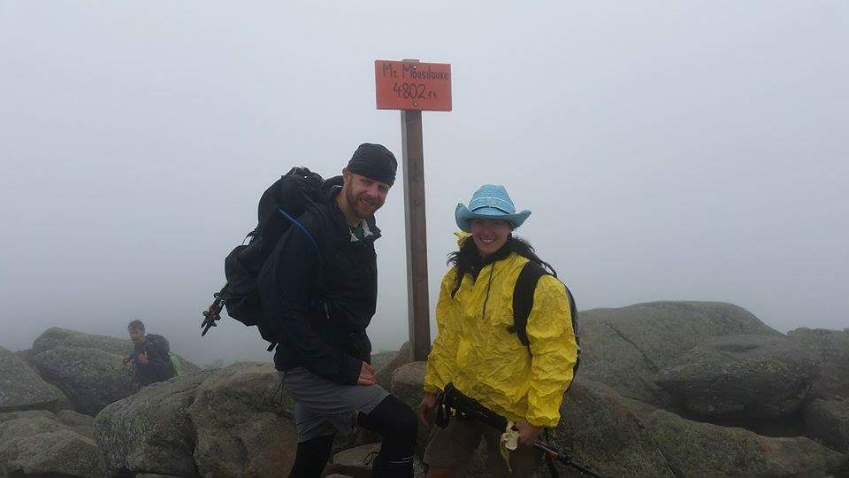
New Hampshire 161 miles
Flip-floppers miss Black Fly Season.

Slide 12
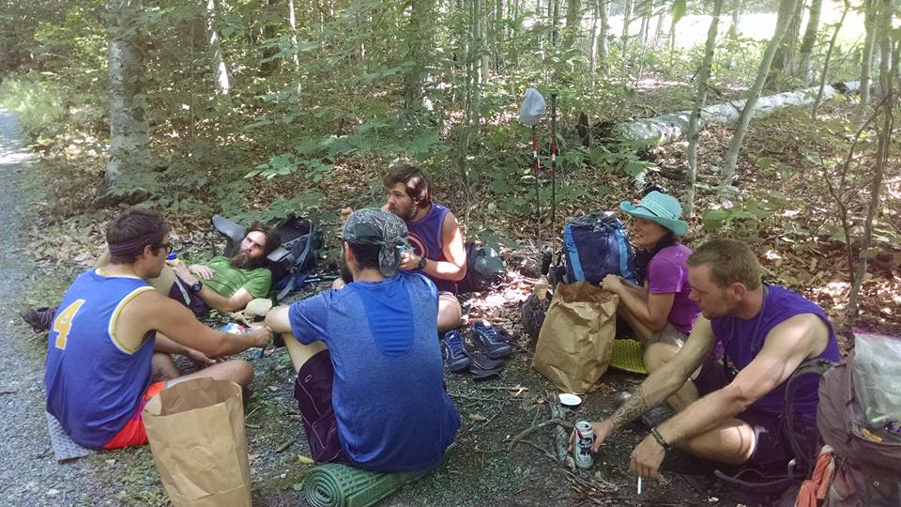
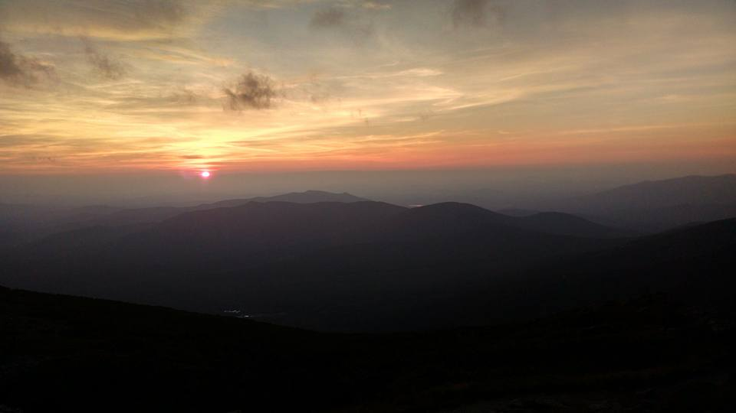
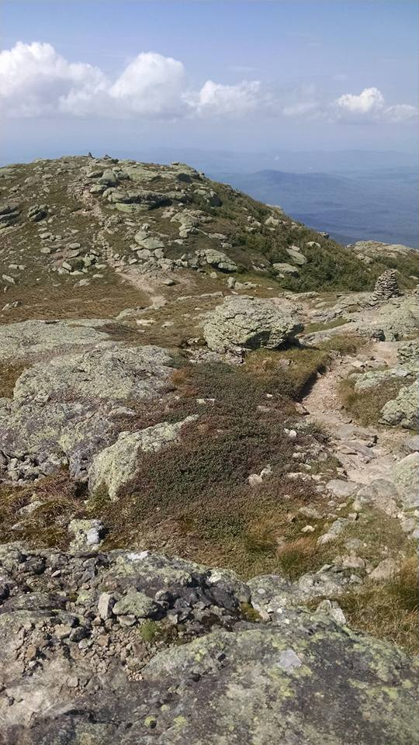
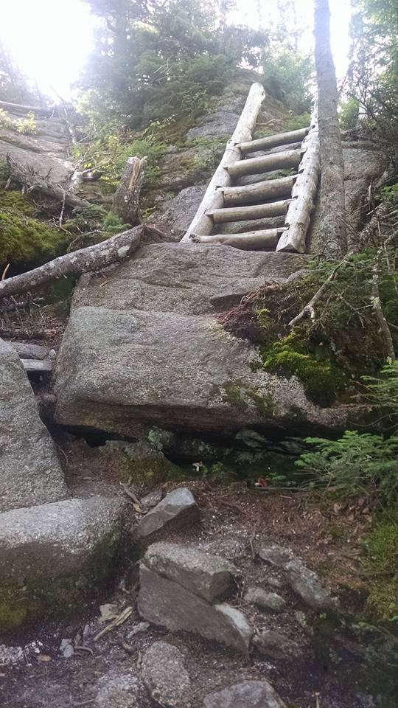






Slide 13








Maine
282 of the hardest miles on the AT!
Flip-floppers have no worries about hiking this challenging terrain in snow and ice!

Slide 14








Slide 15




Maine is perfect in early September!

Slide 16




Virginia
544 miles – The longest state on the A.T. by far!
Flip-floppers get to hike through Virginia in the autumn!

Slide 17







Slide 18






Slide 19





Tennessee
94 miles
This time of year, there are zero bugs!

Slide 20







North Carolina
96 miles
Flip-floppers may see snow, but usually not in overwhelming amounts.

Slide 21





Slide 22





Georgia
76 miles
For those of us in Georgia, flip-flopping allows us to walk ourselves home!

Slide 23




Total Appalachian Trail
2,189 miles
14 states
~5,000,000 steps
165,000 white blazes
More than 250 shelters
3 National Parks
6 months, 2 days
13 bears
Nicknamed “The Green Tunnel”

Slide 24
California’s John Muir Trail
June 25, 2021 – July 10
“Clarity”

Slide 25






Slide 26



Slide 27





Slide 28



Slide 29




Slide 30



Slide 31



